Slide 1


Umamaheswaran & Vishnu Balachandran
Senior Software Engineer – BizTalk360
Introduction to Azure API Apps
Notes:
1.00

Slide 2
Agenda
Introduction to API
Challenges authoring and consuming APIs
Azure API Apps
Demo
Develop API
Discoverability
Deployment
Authentication
Consuming APIs
Notes:
30 secs

Slide 3
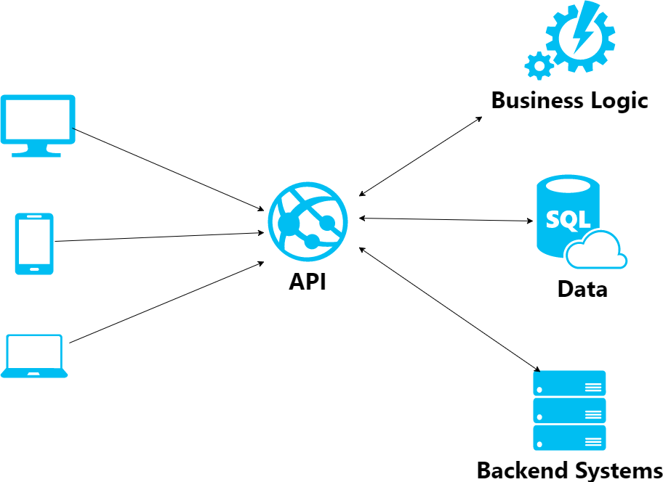
What is API?
Application Programming Interface
Exposing Services and Logic
Web API leverages HTTP Protocol
Availability and Security can be challenging
How Azure App Service can solve this
Notes:
Application Programming Interface
Exposing services and logic in ways which could be easily leveraged by other services and developers
A web API makes it easy to build services and logic over HTTP protocol
It’s a great effort to create availability and security by managing the services themselves in a reasonable and standardized way.
Azure App Service can handle this for us

Slide 4
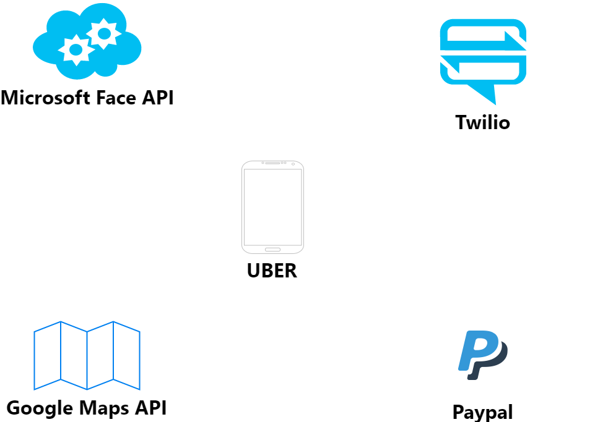
API Scenario

Slide 5
Challenges Authoring APIs
Manual plumbing: Logging, Auth/SSO, config, updating, versioning
Difficult to integrate
No governance or monitoring of API performance without separate API management product
Monolithic designs complicating versioning, agility and scale
Notes:
30 secs

Slide 6
Challenges in consuming APIs
Difficult for professional developers; impossible for business users
Inconsistent metadata and authentication story
Lack of organizationally scoped galleries
Inconsistent (or lack) of API documentation

Slide 7
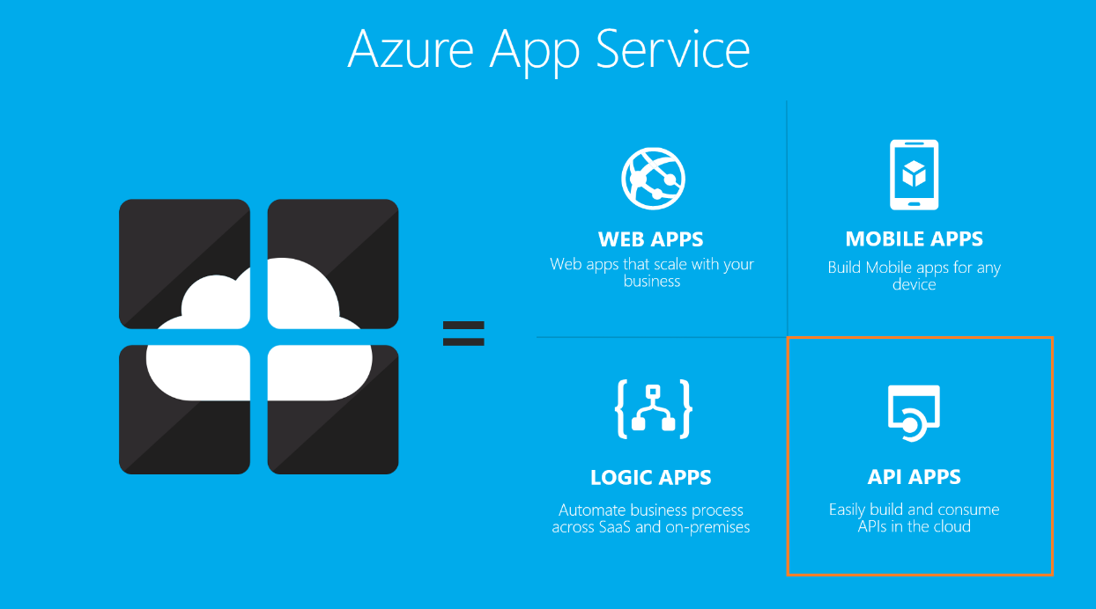
Notes:
API Apps are a part of Azure App Service Offering

Slide 8
Azure API Apps
Develop
Host
Consume
Security
Integration

Slide 9
Why Azure API Apps?
Bring your API as-is
Simple access control
Swagger metadata
Logic App Integration
Visual Studio tooling and support
Automatic updates
Notes:
benefits

Slide 10
DEMO

Slide 11




Slide 12
Questions?

